Slide 1
Infectious foot rot (IFR)
Contagious foot rot, Infectious pododermatitis, foul in the foot

Slide 2
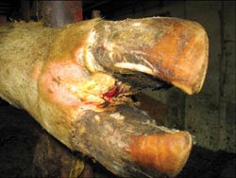
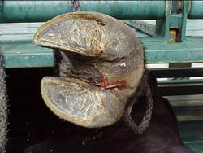
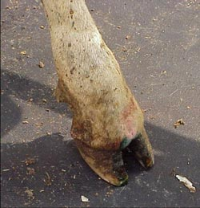
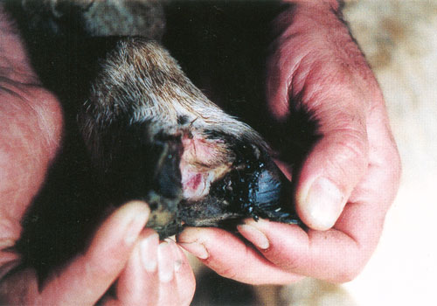

Slide 3
Definition
It is contagious disease of ruminants, caused by fusobacterium necrophorum, characterized by inflammation of feet sensitive tissue resulting in severe interdigital dermatitis and lameness.

Slide 4
Etiology
Fusobactreium necrophorum with other bacteria as Dichelobacter (bacteroides) melaninogenicus and nodosus. The organism produces proteolytic enzymes which destruct foot keratin resulting in horn separation.

Slide 5
Predisposing factors
Wet muddy areas, stony ground or contain sharp gravel,
chorioptic bovis infestation,
mineral deficiency especially zinc and
excessive wetting of interdigital space skin facilitate entrance of infection

Slide 6
Epidemiology
Distribution:
The disease is worldwide distributed and present in Egypt.
Animal susceptibility:
Sheep, goats, cattle and buffaloes, all ages including young ones may be infected but it is more common in adults.
Mode of infection:
Source of infection: The main source of infection is discharge from the feet of infected animals.
Mode of transmission: The infection gain entrance through abrasion on the lower part of foot.

Slide 7
Pathogenesis
Maceration of the interdigital skin from prolonged wet conditions underfoot allows infection with F. necrophorum.
This initial local dermatitis associated with infection with F. necrophorum at the skin and the skin-horn junction, but the hyperkeratosis induced by this infection facilitates infection by D. nodosus if it is present.
The preliminary dermatitis has been named 'ovine interdigital dermatitis' and is also called "foot scald".
The infection is spread to adjacent tendon sheath, joint capsules or bone if delayed or ineffective treatment is adopted.

Slide 8
Clinical Signs
Incubation period is 20 days, the disease is sporadic and a mortality rate is low.
Infectious foot rot is characterized by fever (39-40 ºC), swelling of coronet and interdigital skin causes blind fouls, sudden severe foot lameness usually in one limb or recumbency.
Long continued irritation causes formation of wart-like mass of fibrous tissue or interdigital fibroma.

Slide 9
Postmortem lesions
Dermatitis and necrosis of interdigital skin and S/C tissues with suppuration and involvement of tendon sheath and joints in complicated cases.

Slide 10
Diagnosis
Field diagnosis:
The disease suspected from clinical signs as swelling of interdigital skin accompanied with foul odor beside the epidemiology and history of the disease.
Laboratory diagnosis:
Samples: Pus, swabs from the lesions, blood and serum.
Laboratory procedures:
Examination of direct smear to see large number of a mixture of fusibacterium and bacteroides sp.
Hematological and serum biochemical studies.
Serotests.

Slide 11
Differential diagnosis
Foot abscess, it characterized by extensive suppuration. The abscess occurs in a single claw on the foot
Other diseases with foot lameness include:
Contagious echyma
Bluetongue
Foot and mouth disease
Ulcerative dermatosis
Strawberry foot rot
Laminitis

Slide 12
Treatment
Topical treatment:
Most topical treatments require that all under run horn be carefully removed so that the antibacterial agent to be applied can come into contact with infective material.
Local applications include chloramphenicol (10% tincture in methylated spirits or propylene glycol), oxytetracycline (5 % tincture in methylated spirits), zinc sulfate (10% solution) and copper sulfate (10% solution).
Foot bathing for treatment and control Foot bathing is a more practical approach to topical treatment and for control during transmission periods, when dealing with large numbers of sheep. Preparations suitable for footbaths include 5% copper sulfate, 5 % formalin and 10% zinc sulfate with or without a surfactant to aid wetting of tissues.
Systemic treatment: Systemic antibiotic as Pencillin 10.000IU/kg, Erythromycin. Single 1M dose of 10 mg/kg, Long-acting oxytetracycline. Single 1M dose of 20 mg/kg. Lincomycin/spectinomycin. Single SC dose of 5 mg/kg lincomycin and 10 mg/kg spectinomycin.

Slide 13
Control
Detection of infected cases and immediate isolation with early treatment.
Culling of incurable cases and prevent of foot injury by avoiding muddy or stony yards.
Provision of foot bath containing 5-10% formalin or cupper sulfate in a door way.
Feeding of chlortetracycline to feed lot animals may reduce incidence (500 mg /head of cattle for 28 day then 75 mg /head throughout fattening period).

